Slide 1
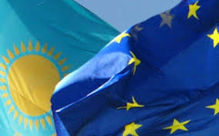
The Role of Italy in the Development of Kazakhstan-EU Energy Relations
EUCE Conference at UVic - July 16-18
Presenter: Lyailya Nurgaliyeva
PhD candidate
Kyushu University

Slide 2
Contents
Purpose of the research
Impact of Kazakhstan into European energy security
Italy as the largest importer of Kazakhstan's oil
Kazakhstan’s goal to diminish its dependence on non-renewable energy resources

Slide 3
Purpose of the research
Kazakhstan researchers, Nargis Kassenova and Laumulin Murat argue that Kazakhstan and the EU attempt to enhance the energy dialogue and they examine this dialogue in the big EU framework without emphasizing particular actors.
A “medium-size power”, such as Italy, could contribute into the development of Kazakhstan-EU energy relations based on the case of Kashagan.
Research Questions:
  What place does Kazakhstan take in EU energy security?
  Why is Italy important for Kazakhstan among the EU member states?

Slide 4
Impact of Kazakhstan into European energy security
Kazakhstan-EU relations before Crimea
Pipeline monopoly of Transneft.
2006, Kazakhstan’s diversification of oil exports (Atyrau–Alashankou and BTC pipeline).
November 2006, a memorandum of understanding (MoU) on cooperation in the energy sphere.
2009 MoU on cooperation over transport issues.
October 2010, Kazakhstan president Nazarbayev’s visit to Brussels.

Slide 5
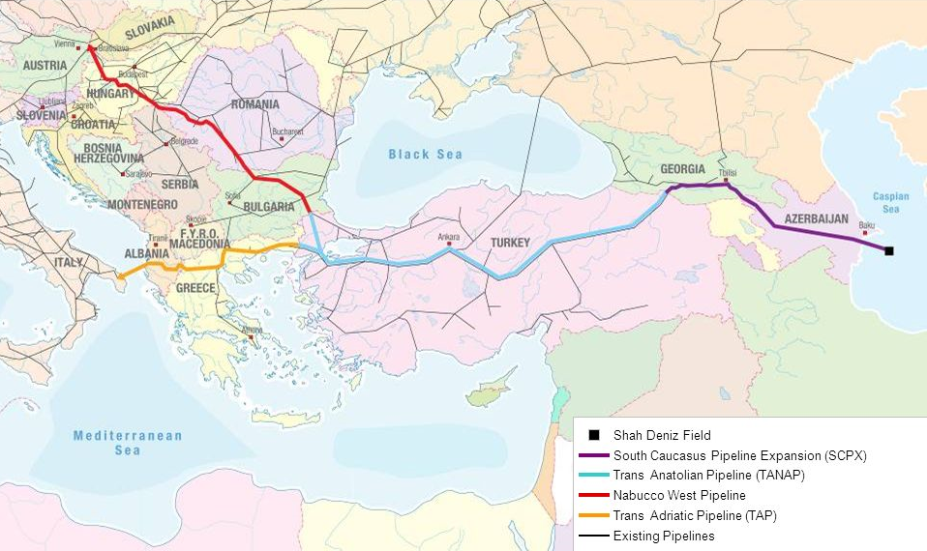
Impact of Kazakhstan into European energy security
Kazakhstan-EU relations after Crimea
There are two scenarios of the pipeline diversification for Europe
Southern Corridor
Transportation of Kazakhstan’s oil through BTC pipeline.
Thus, Kazakhstan could be a credible alternative for Russia.

Slide 6
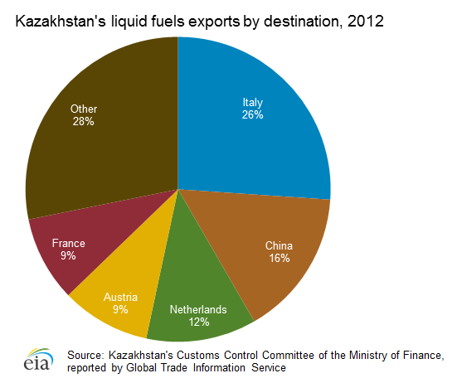
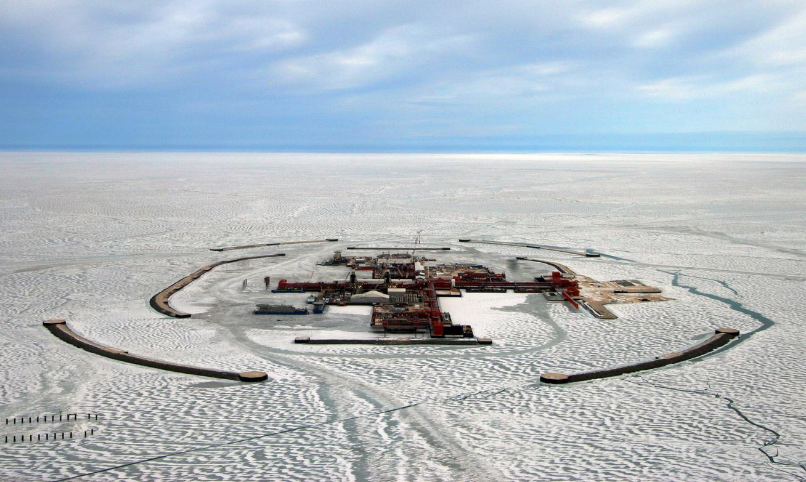
Italy as the largest importer of Kazakhstan's oil
Kashagan field
(Source: US Energy Information Administration)

Slide 7
Kazakhstan’s goal to diminish its dependence on non-renewable energy resources
2010-2014 National Program of forced Industrial and Innovative Development of Kazakhstan.
Advance development of non-oil and gas sectors:
  agro-industrial complex, light industry, tourism
  information and communication technologies, biotechnologies, alternative energetics, space activities

Slide 8
Italy’s importance for Kazakhstan among the EU member states
Italy is one of the priorities of Kazakhstan's foreign policy, which considers Italy as a reliable political, as well as economic partner.
In comparison with 2002, the mutual trade turnover of 2007 increased in almost 7 times.
Italy is one of the top countries with 10.2% in share of EU high-tech.
Romano Prodi was an important factor in achieving close cooperation of EU with Kazakhstan.

Slide 9
Conclusion
As explained, it is Italy that is leading Kazakhstan’s cooperation with the EU, Kazakhstan expects to reinforce the cooperation with Italy in the energy field not only in the energy security but shifting toward the renewables with its necessary technologies.

Slide 10


